Slide 2
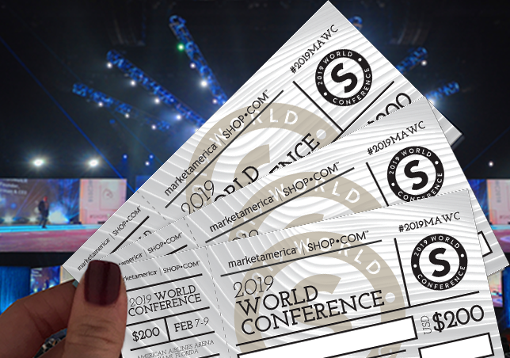
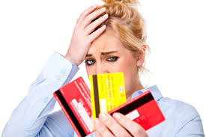
[
]
WHY YOU?
WHY YOU?
Creates new customers
Average $1,000 Retail Profit
230 BV initial Website Sale
Ongoing 5-35BV/mo
Creates new Possibilities
It’s FUN!
Notes:
SR

Slide 3
[
]
WHY US?
WHY B2B SERVICES/MA WEBCENTERS?
More than just websites
Successful over 18 years
Teams of professionals, 24/7 Support
Proven System
Exposes the Other MA Divisions
You know business owners
Notes:
SR

Slide 5
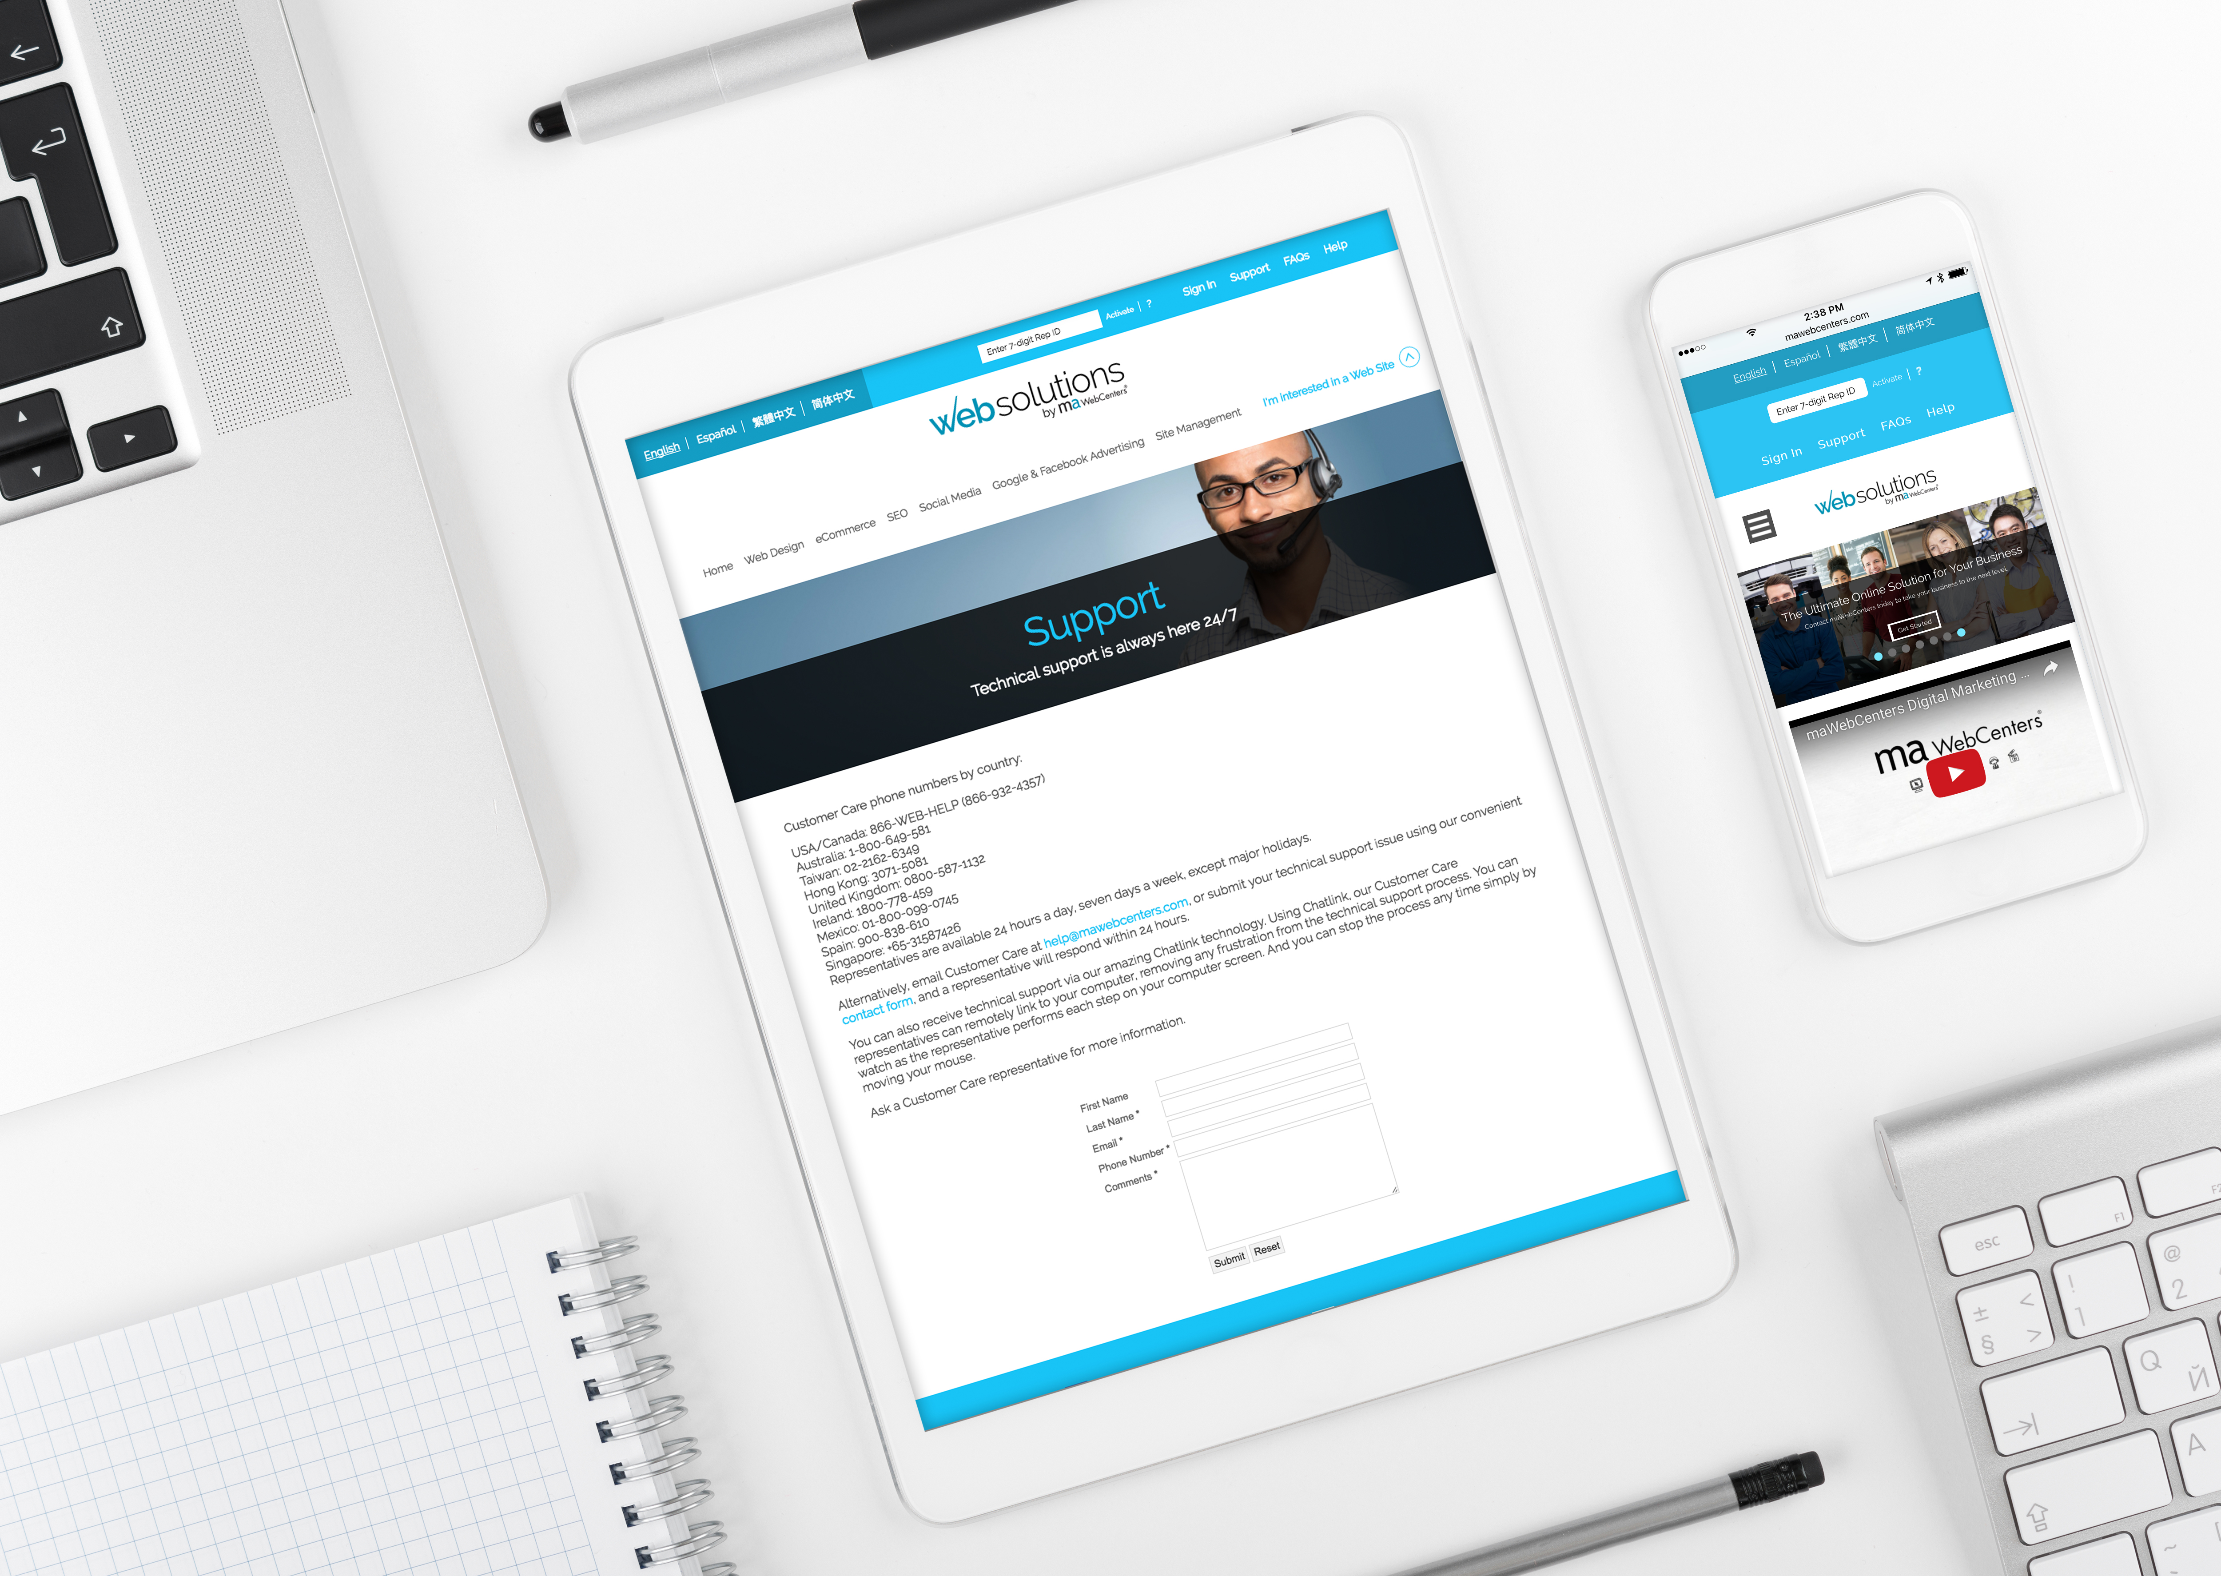
[
]
WHAT?
MA WEBCENTERS
More than just websites
Web Design
Domains and Email
SEO
Social Media
Digital Marketing
Proven System
Notes:
SR

Slide 6
[
]
Shopping Annuity
Notes:
SR

Slide 7
DO BUSINESS OWNERS SPEND MONEY?
Marketing & Advertising
Websites, Domain names, Email addresses
SEO
Email Marketing
Google AdWords
Social Media Management
Facebook Advertising
Other Paid Advertising
Signage
Promotional Products
Clothing & Apparel
Software (POS, Scheduling)
Merchant Services
Insurances, Warranties, Legal/Accounting fees
Technology Updates
Client Gifts
Equipment
Travel and Lodging
Office Supplies
Janitorial Supplies and Sanitation
Breakroom Expenses
Food & Beverage
And on and on and on…..
Notes:
TRAINER’S NOTES:
Self-Explanatory

Slide 8
Businesses spend much more than an average household to run their business!
What if you could help businesses SAVE MONEY on their overhead expenses?
What if you could help businesses EARN CASHBACK for their overhead?
Notes:
TRAINER’S NOTES:
Business Owners spend 4-10x more than the average consumer, opening up an opportunity to discuss ways to save money on their business overhead

Slide 9
Let’s take a look at earning potential
Retail Profit
BV
Growth Potential
Notes:
TRAINER’S NOTES:
Earning potential will be demonstrated in terms of short term and long term growth potential

Slide 10
Australia
Bahamas
Bermuda
Canada
Chile
China
Columbia
Costa Rica
Dominican Republic
Ecuador
Hong Kong
Indonesia
Ireland
Jamaica
Macau SAR China
New Zealand
Panama
Philippines
Singapore
Spain
Taiwan
United Kingdom
United States
YOUR GLOBAL WEBCENTER
Your WebCenter is automatically enabled to sell websites globally in all Market Countries & EMP Countries. You earn Home Country Retail Profit & BV!
Notes:
TRAINER’S NOTES:
What does that do for us?
First, by having websites which are completely in other languages and the entire back end of the system, including the menus and contextual help, the business owners who are more comfortable with another language will be able to take more effective use of the solution.
Second, by providing all the support, from sales to ongoing support with clients, all in multi-languages.
As a non-native speaker, you can probably find numerous business owners who you can have a short conversation to set an appointment with, but you wouldn’t be able to do a sales walkthrough because the business owner might not understand English well enough. This way, all you need to do is set the appointment, and let the team handle the rest for you!
And we all know that some of your best business prospects are business owners and customers of yours. This is a very natural way to lead to prospects for the business in a cultural market you might not have thought you could make inroads to.

Slide 11
AVERAGE RETAIL PROFITS :
USA, CAN, AU, SGP: $1,000
UK: £700
HK: HK$7,700
TW: NT$32,000
Divide your short term goal by your average
retail profit to determine how many sales it will take to reach your goal.
For example: A WCO has $5,000.00 in debt divided by $1,000.00 = 5.
Therefore, just 5 new sales could pay for the initial goal of $5,000.
Short term goals can be met with retail profits
Notes:
TRAINER’S NOTES:
Again – you can apply this to any of your fixed cost goals

Slide 12
Each website sold
Generates at least 230 BV
Each active client
generates
5, 30 or 35 BV / Mo.
DIGITAL MARKETING PRODUCTS GENERATE ADDITIONAL BV AND RETAIL PROFITS
Notes:
TRAINER’S NOTES:
Long Term Potential for WCOS = Ongoing BV and Retail Profits
Describe Business Volume as a unit point value attached to each product and service based on profit margin which will accumulate to pay out additional commissions on Gross Business (Sales) Volume.

Slide 13
A PROVEN, DUPLICATABLE, SYSTEM TO PROVIDE
SMALL BUSINESS OWNERS AN EFFECTIVE INTERNET PRESENCE
TOGETHER, WE HELP BUSINESSES AND ORGANISATIONS WITH:
Increasing Revenues
STREAMLINING BUSINESS PRACTICES
Decreasing Expenses
INCREASING ENGAGEMENT
Increasing Customer Satisfaction
MARKETING THEIR BUSINESS
Notes:
SR

Slide 14
WE OFFER SOLUTIONS THAT ARE:
PROFESSIONAL
AFFORDABLE
EASY TO MAINTAIN
ALL-INCLUSIVE
SECURE
SUPPORTED
A PARTNERSHIP
Notes:
TRAINER’S NOTES:
Our solution offers professional, affordable solutions to being effective online
We know it’s overwhelming, and are proud to offer simplicity back into your life so you can focus on more important things, like running your business

Slide 15
MORE THAN JUST A WEBSITE
Unlimited Pages
Unlimited Changes
Unlimited Traffic
Unlimited Email Address and Email Marketing Campaigns
Unlimited Web Content Storage
24/7 Unlimited support, changes and upgrades.
We take away the challenges that business owners face to stay current with their online marketing solution.
Notes:
Trainers Notes:
This is just an intro slide – The goal here is to get them excited about what we are going to talk about.
In brief, cover the big topics “Websites, Marketing Tools, Unlimited, Support, Security)
The goal is to paint a simple picture of how all –inclusive our solution actually is / Instill confidence in the product.
Spend 1 minute or less on this slide – the details are coming up!

Slide 17
WEBSITE HOSTING & MANAGEMENT
Basic Monthly Membership Monthly Maintenance & Management Managed Monthly Membership
SOCIAL MEDIA
DIGITAL MARKETING
Local SEO, Regional SEO, Google Advertising, Content Writing, Wordpress.org
SOCIAL MEDIA
Social Media Management, Online Reputation Management, Facebook Advertising
EMAIL MARKETING
Email Marketing Campaign Tool build right into the website platform
WWW.MAWC411.COM
Notes:
TRAINER’S NOTES:
Showcases all of the services that a client can purchase through maWebCenters
The big difference is whether someone will do it themselves, or leverage our teams of experts to do it for them

Slide 18
AWARD WINNING UNLIMITED CUSTOMER CARE
Unlimited help editing the site
Support using all features & tools in our solution
Home country, 24/7 support
Ultra-secure hosting facility 24x7 Security and incident monitoring, hosted on tiered, high performance Dell PowerEdge servers, protected from fire, floods, earthquakes, power outages, and other types of disasters
Dual-layer firewall protection Using Cisco PIX firewalls
Notes:
Trainers Notes:
Share Stories!

Slide 19
A PROVEN SYSTEM FOR SUCCESS
YOU TALK TO BUSINESS OWNERS & SET APTS.
OUR TEAMS
SALES,
DESIGN, DIGITAL
YOUR CLIENT
GREAT SITE & SUPPORT
Notes:
TRAINER’S NOTES:
We’ve all set some initial goals but did we take them seriously?
Did you hit your goals in the past? Why /Why not?
Was your action plan on track to help you get what you want?
Revising your goals will help to create smarter goals with proper action plans
Better action plans = better quality work time AND better quality play time

Slide 20
OUR SYSTEM IS BUILT ON SELLING APPOINTMENTS
THEN LEVERAGING OUR TEAMS OF PROFESSIONALS TO DO ALL OF THE HEAVY LIFTING
Notes:
TRAINER’S NOTES:
You are not the sales, design or technical expert
There are professional teams that work for you who will do this heavy lifting for you

Slide 21
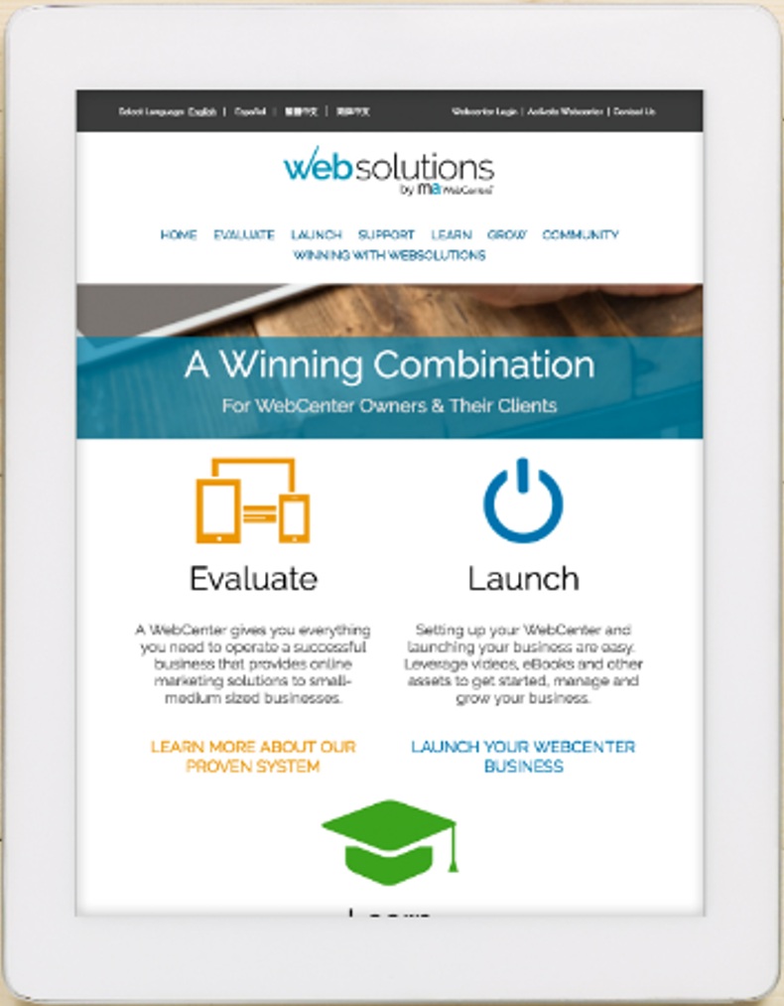
[
]
HOW TO SUCCEED?
LEARN ONLINE
Monthly WebCenter Overviews
WebCenter Owner Overview
WebCenter Pro Overview
(WC Pro International Coming soon!)
WebCenter Training
Online Learning Center
Level Up Challenge
www.mawc411.com
Notes:
SR

Slide 22
Level Up Challenge
Now through July 31, 2019
Weekly Training & Accountability
Learn how to succeed with WebCenters
Compete for Monthly & Overall Prizes and Awards
Recognition Badges of Success
Register at www.mawc411.com

Slide 23
OWN A WEBCENTER – EVENT SPECIAL
The Codes for Free Event Special will expire
May 10, 2019
Order Code: 7WCSP for NEW WebCenter
76051RA to Reactivate a WebCenter

